Slide 1
clouds
clouds

Slide 2
clouds
Clouds are

Slide 3
clouds
Clouds are big mass made of drops of water or little ice crystals

Slide 4
types
There are many diffrent types clouds like

Slide 5
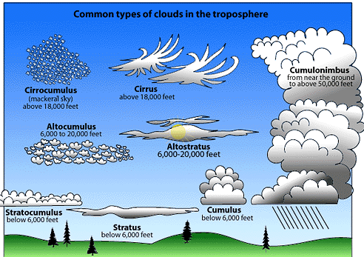
types
Roll clouds, tunnel clouds, and others.

Slide 6
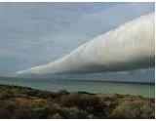
Roll clouds
Roll clouds are when srtong winds hit the edge of a cloud and forme it

Slide 7
Tunnel clouds
Tunnel clouds are when a strong wind pushes the edge of the cloud and turns it into a tunnel and starts to roll away

